Slide 1
OR Mapping

Slide 2
HBM HEADER
<hibernate-mapping schema="schemaName" (1)
default-cascade="none|save-update" (2)
auto-import="true|false" (3)
package="package.name" (4) />
(1) schema (optional): The name of a database schema.
(2) default-cascade (optional - defaults to none): A default cascade style.
(3) auto-import (optional - defaults to true): Specifies whether we can use unqualified class names (of classes in this mapping) in the query language.
(4) package (optional): Specifies a package prefix to assume for unqualified class names in the mapping document.

Slide 3
Property mapping
<property name="description" column="DESCRIPTION" type="string"/>
<property name="description" type="string">
<column name="DESCRIPTION"/>
  </property>

Slide 4
Property formula
<property name="averageBidAmount"
formula="( select AVG(b.AMOUNT) from BID b
where b.ITEM_ID = ITEM_ID )“ type="big_decimal"/>

Slide 5
Property access strategies
<property name="name" column="NAME" type="string" access="field|property|ClassName "/>

Slide 6
Controlling insert and updates
<property name="name“ column="NAME“ type="string“ insert="false"
update="false"/>
The property name of the JavaBean is therefore immutable and can be read from
the database but not modified in any way
If the complete class is immutable, set the immutable="false" in the class mapping
<class name="org.hibernate.auction.model.User“ dynamic-insert="true"
dynamic-update="true">
</class>
These are both class-level settings.

Slide 7
Quoted sql identifiers
<property name="description“ column="`Item Description`"/>
This property declaration forces Hibernate to generate SQL with the quoted
column name "Item Description". Hibernate will also know that Microsoft SQL
Server needs the variation [Item Description] and that MySQL requires `Item
Description`.

Slide 8
SQL Schema
<hibernate-mapping>
<class name="org.hibernate.auction.model.Category"
table="CATEGORY"
schema="AUCTION">
</class>
</hibernate-mapping>
<hibernate-mapping default-schema="AUCTION">
</hibernate-mapping>

Slide 9
Declaring class names
<hibernate-mapping>
<class name="org.hibernate.auction.model.Category" table="CATEGORY">
</class>
</hibernate-mapping>
<hibernate-mapping package="org.hibernate.auction.model">
<class
name="Category"
table="CATEGORY">
...
</class>
</hibernate-mapping>

Slide 10
Db Identity
<class name="Category" table="CATEGORY">
<id name="id" column="CATEGORY_ID" type="long">
<generator class="native"/>
</id>
.</class>
<id column="CATEGORY_ID">
<generator class="native"/>
</id>
Long catId = (Long) session.getIdentifier(category);

Slide 11
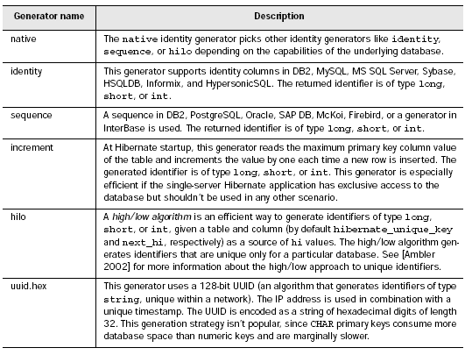
Identities supported by hibernate

Slide 12
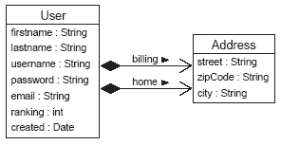
Composition in hibernate

Slide 13
Mapping
<class name="User“ table="USER">
<id name="id“ column="USER_ID“ type="long">
  <generator class="native"/>
</id>
<property name="username“ column="USERNAME“ type="string"/>
<component name="homeAddress“ class="Address">
  <property name="street“ type="string“ column="HOME_STREET“ notnull="true"/>
  <property name="city“ type="string“ column="HOME_CITY“ not-null="true"/>
  <property name="zipcode“ type="short“ column="HOME_ZIPCODE“ not-null="true"/>
</component>
<component name="billingAddress“ class="Address">
<property name="street“ type="string“ column="BILLING_STREET“ notnull="true"/>
<property name="city“ type="string“ column="BILLING_CITY“ not-null="true"/>
<property name="zipcode“ type="short“ column="BILLING_ZIPCODE“ not-null="true"/>
</component>
</class>

Slide 14
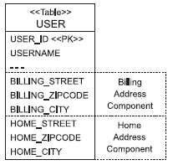

Slide 15
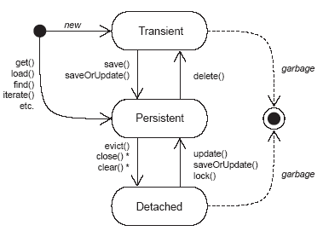
Transient Object

Slide 16
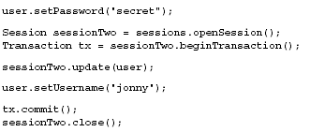
Updating a persistent state of detached instance

Slide 17
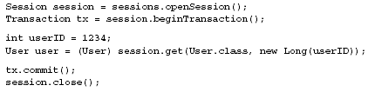
Retrieving a persistent object

Slide 18
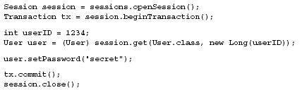
Updating a persistent object

Slide 19
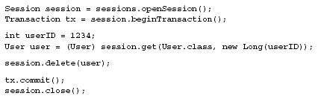
Making a persistent object transient

Slide 20
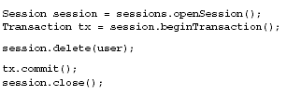
Making a detached object transient

Slide 21
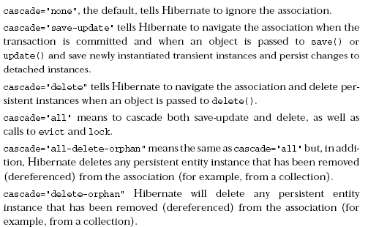
Cascading persistence with Hibernate

